Slide 1
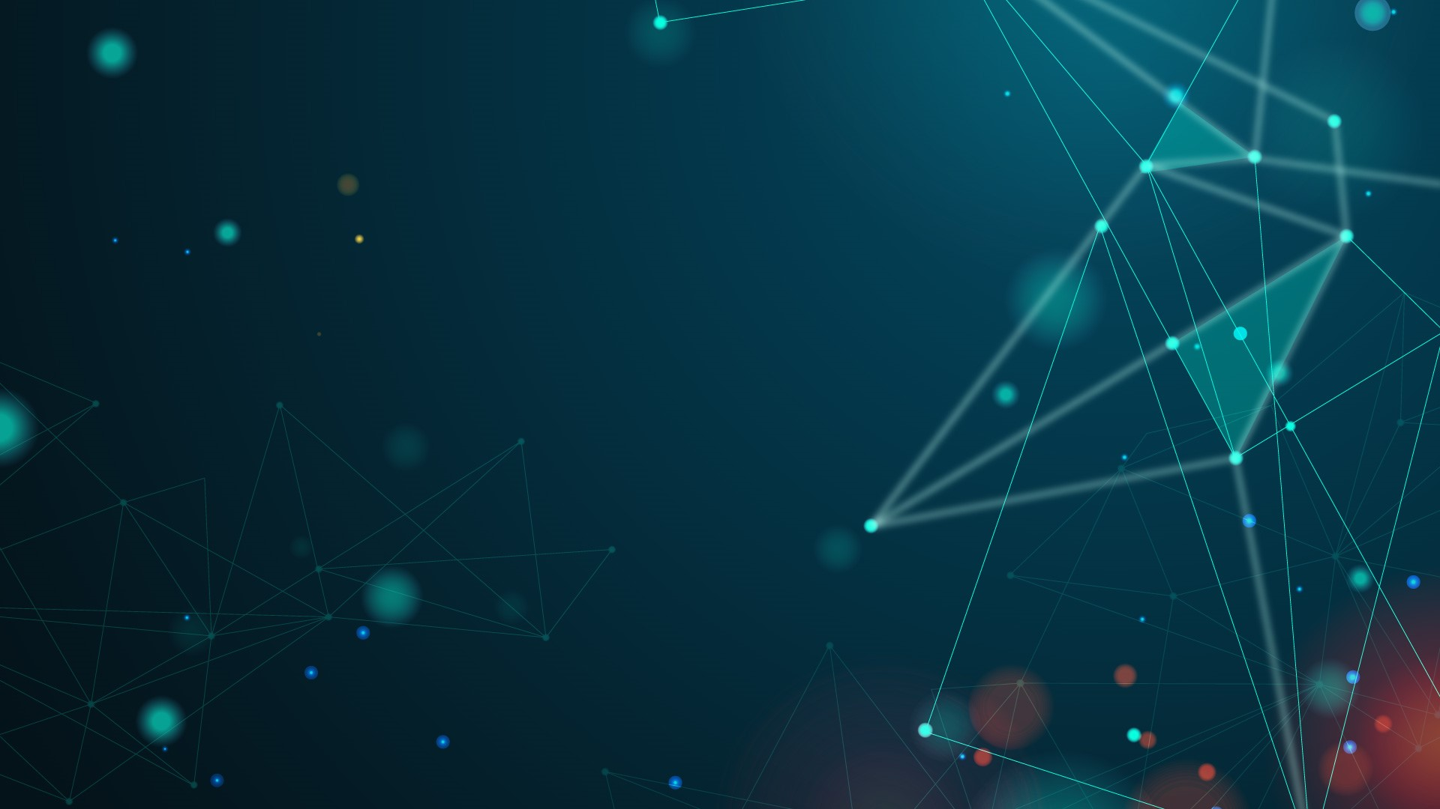

Facial Emotion Detection
Jeff Stearns

Slide 2
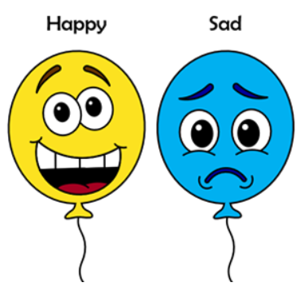
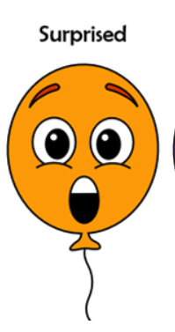
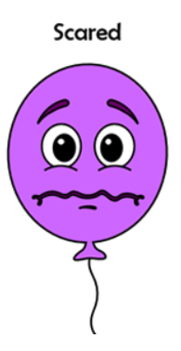

PROBLEM DEFINITION
Can emotion be accurately detected by Convolutional Neural Networks (CNN)?
Self driving car, detect drowsy or distracted.
Potentially assist with security: Predict dangerous behaviors by reading emotions.
Detect emotional response of customers to advertisement.

Slide 3
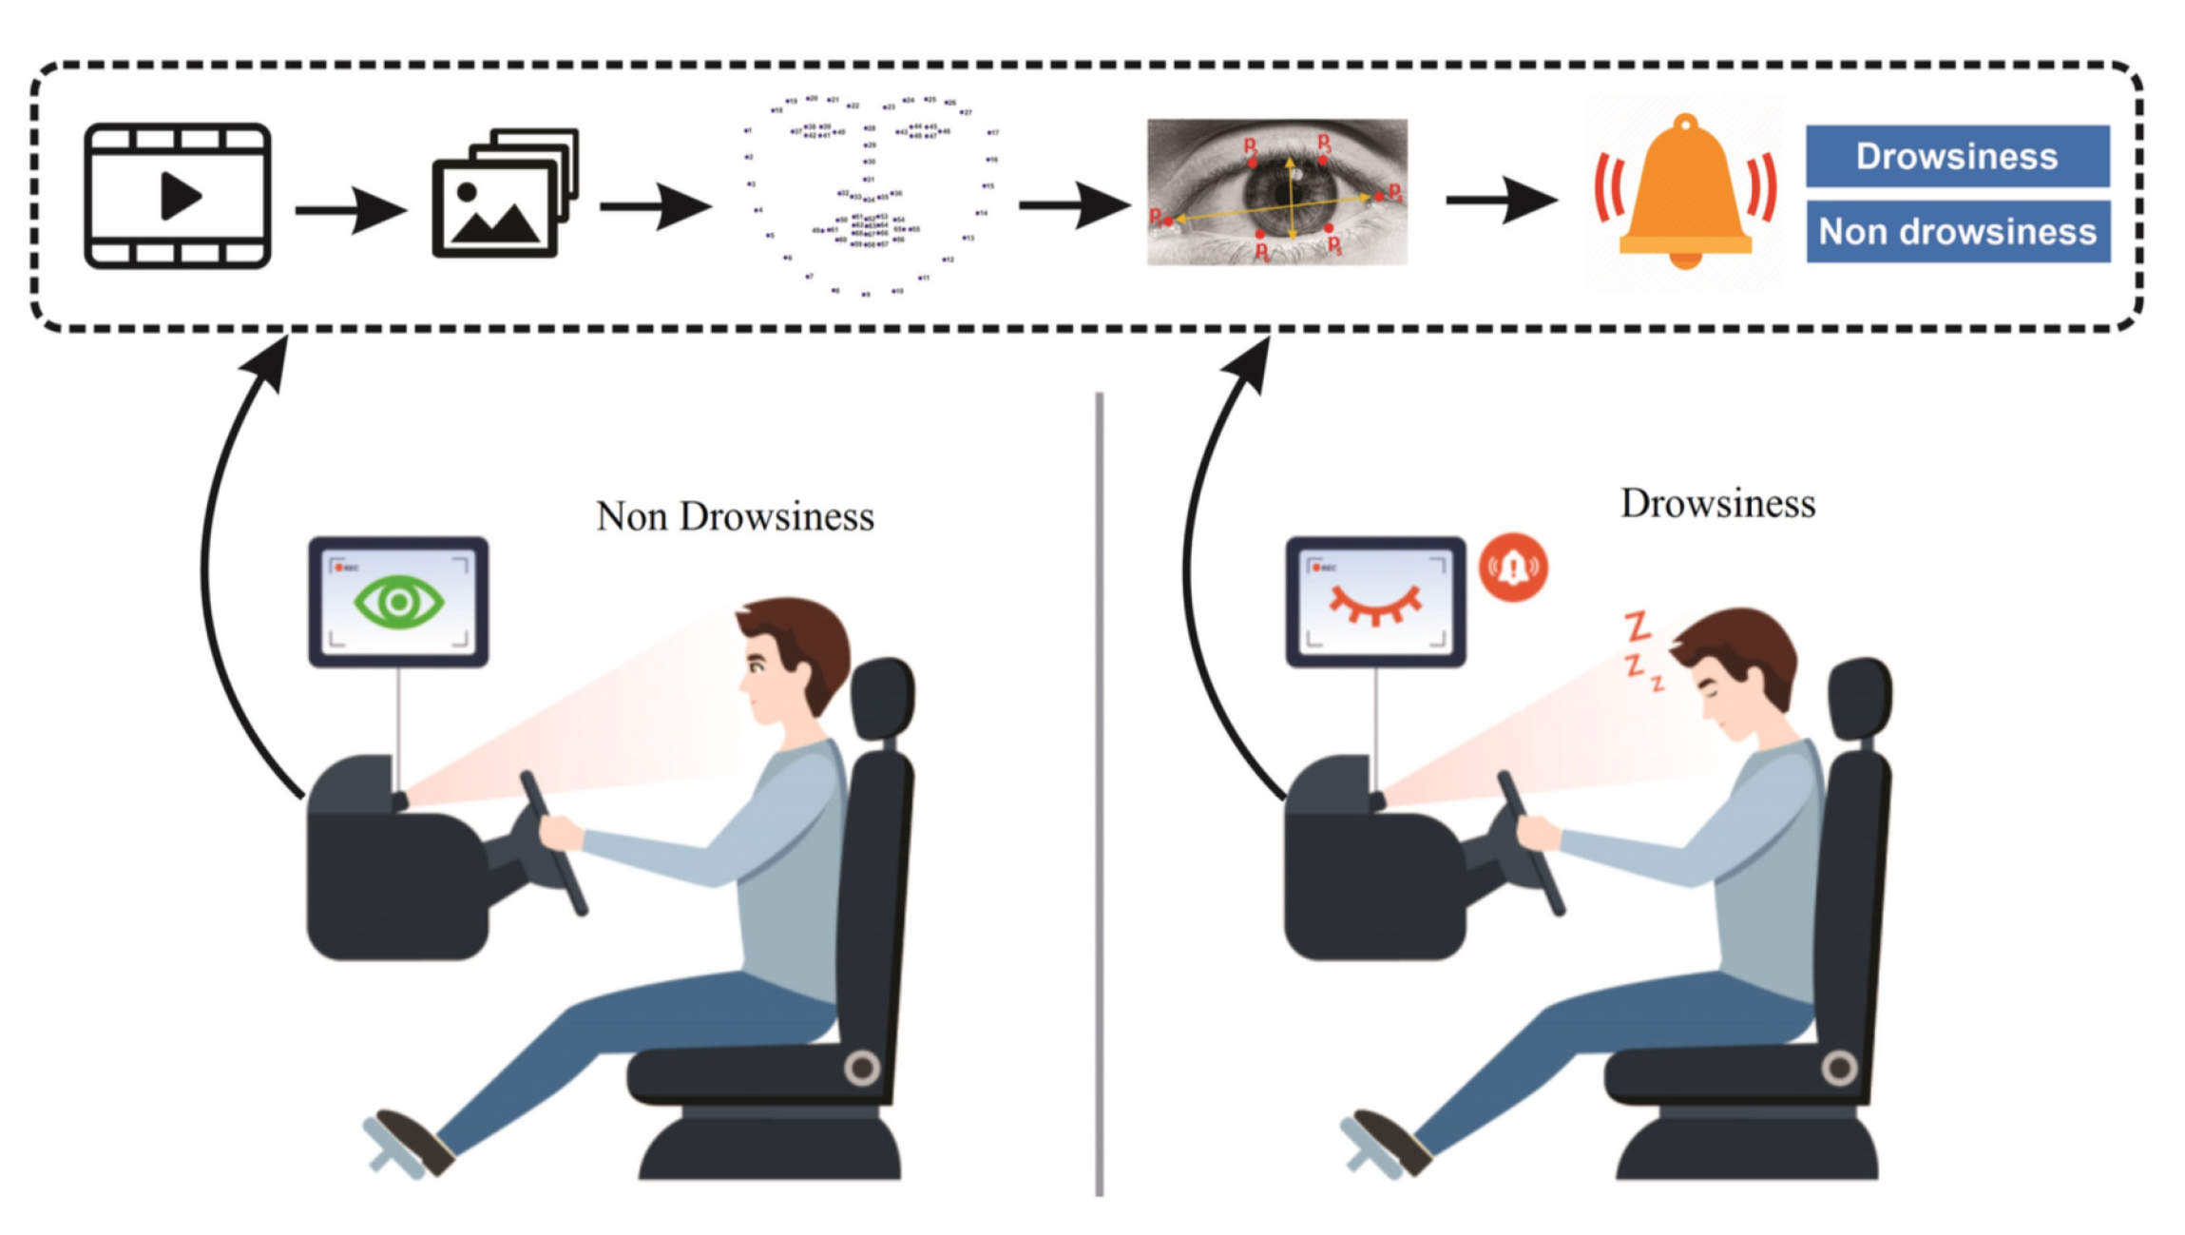
FACIAL EMOTION DETECTION USE CASE 1
Autopilot Automobiles : Driver alertness still required, sensors and software are not perfect.

Slide 4
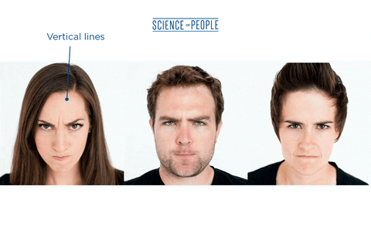
FACIAL EMOTION DETECTION USE CASE 2
Security alert, detect potentially dangerous individual through emotion recognition.

Slide 5
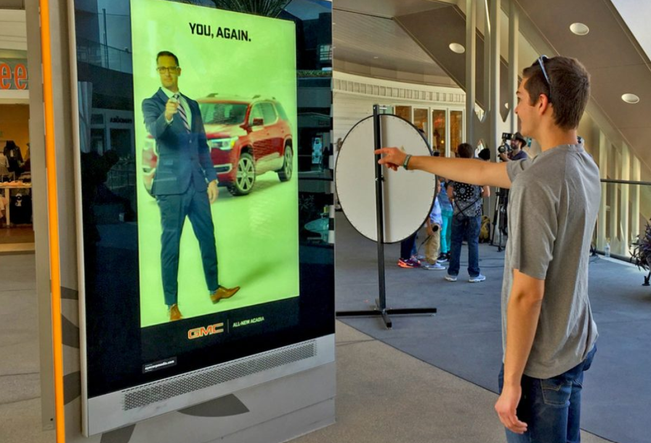
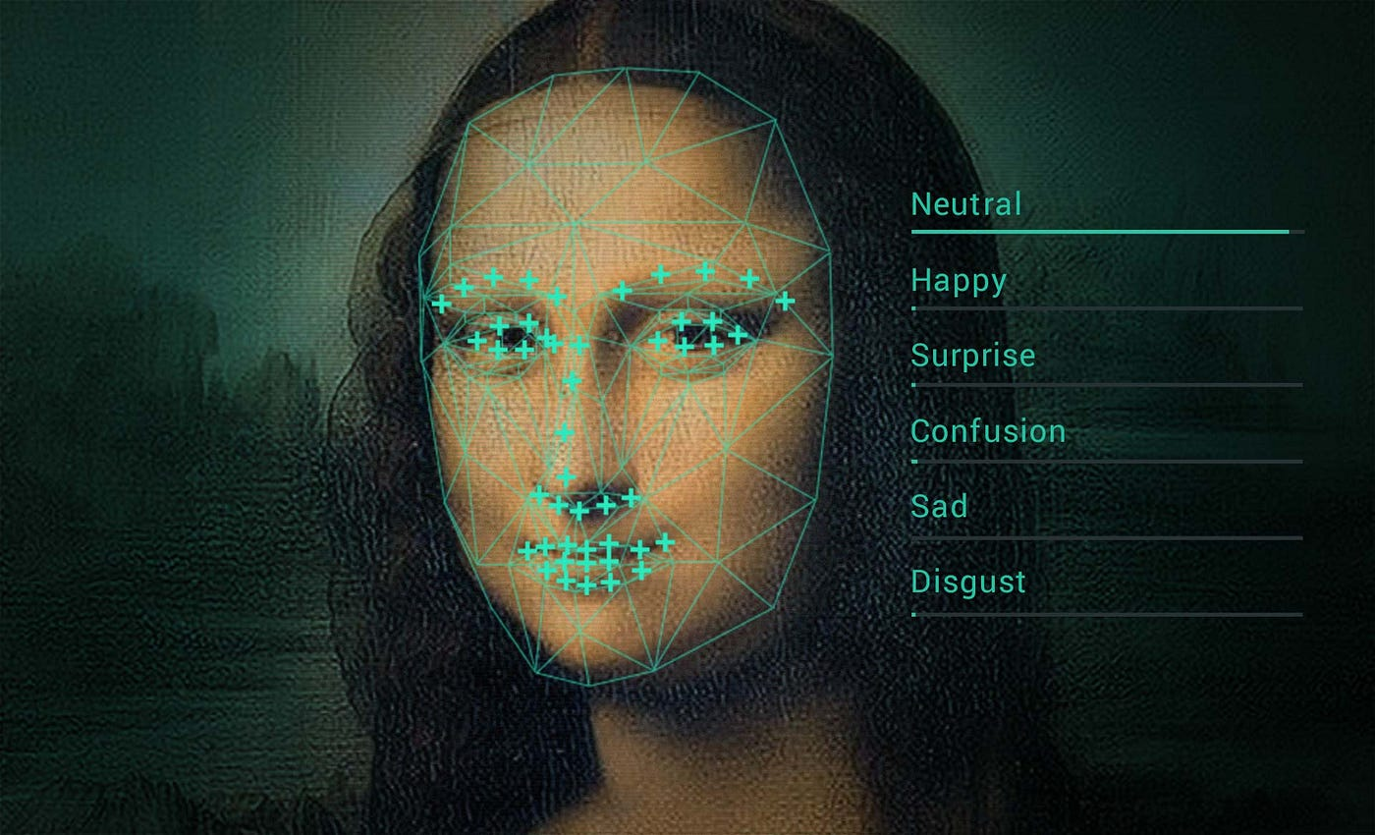
FACIAL EMOTION DETECTION USE CASE 3
Detect emotional response of customers to advertisement.

Slide 6

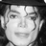

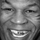
DATA SET ANALYSIS
Facial_emotion_images.zip
Black and White Images : 48 Pixel Squares
Example Images
Happy
Neutral
Sad
Surprise

Slide 7
DATA SET ANALYSIS
TRAINING | VALIDATION | TEST
Mercury is small Mercury is the closest planet to the Sun Mercury is the closest planet to the Sun and the smallest of them all | Venus is very hot Venus is the second planet from the Sun Venus has a beautiful name and is the second planet from the Sun | Jupiter is big Jupiter doesn’t have a solid surface Jupiter is a gas giant and the biggest planet in the Solar System
$10 | $50 | $100

Slide 8







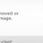
DATA SET ISSUES
No face, watermark, multiple face, cartoon
train\happy
train\sad
test\happy

Slide 9
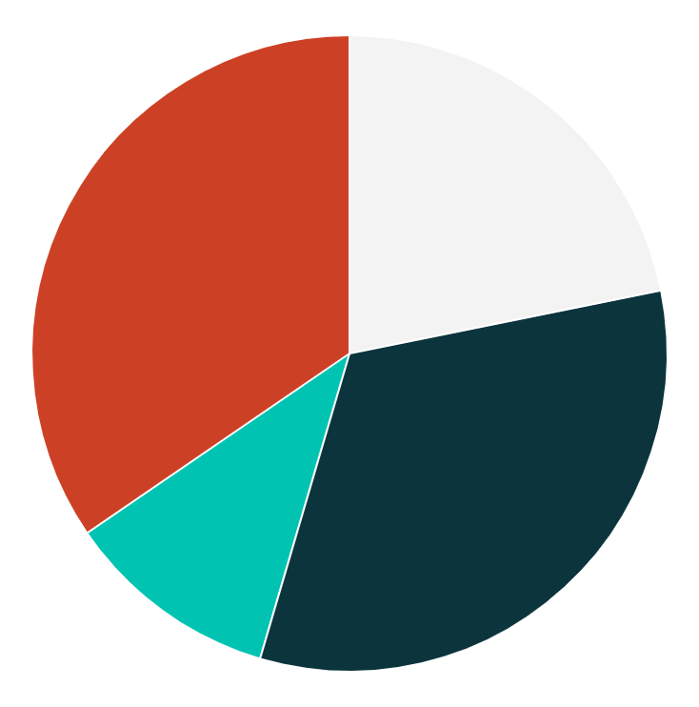
CONVOLUTIONAL NEURAL NETWORK (CNN) MODELS
TOP LEVEL OVERVIEW
24%
36%
MERCURY
VENUS
Mercury is the closest planet to the Sun
Venus is the second planet from the Sun
12%
38%
MARS
JUPITER
Despite being red, Mars is very cold
Jupiter was named after a Roman god
Follow the link in the graph to modify its data and then paste the new one here. For more info, click here

Slide 10
DATASET LOADERS
OUR HEADQUARTERS

Slide 11
CNN MODEL 1
SALES FUNNEL
AWARENESS
Mercury is a small planet
INTEREST
Mars was named after a god
DECISION
Jupiter is a very big planet
PURCHASE
Saturn is a gas giant with rings

Slide 12
AI TECH AGENCY INFOGRAPHICS
HOW WE DO IT
01
02
03
04
MARS
JUPITER
EARTH
MERCURY
Mars is actually a very cold place
Jupiter is a very big planet
Earth is the planet with life
Mercury is a small planet

Slide 13
AI TECH AGENCY INFOGRAPHICS
JOHN WILLIAMS
PERSONALITY TRAITS
Age: 30 years old
Mercury is a small planet
Venus is a hot planet
We all live on Earth
Mars is made of basalt
Gender: Male
Job: Developer
Origin: USA
Likes: Travel, art, music
MOTIVATIONS
“Saturn is a gas giant and has several rings. It's composed mostly of hydrogen and helium. It was named after the Roman god of wealth and agriculture”
Price
50%
Comfort
90%
Speed
80%

Slide 14
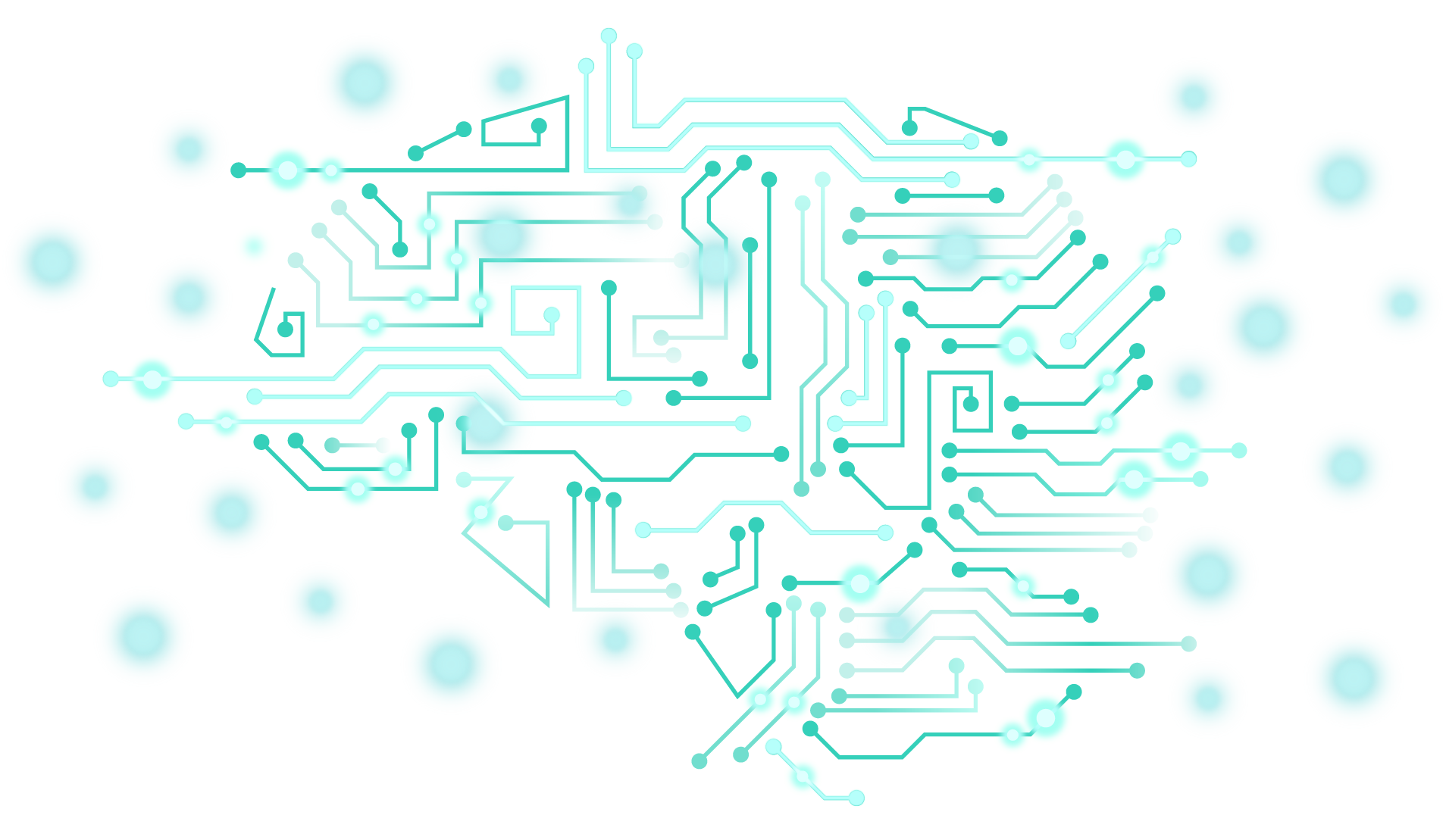
AI TECH AGENCY INFOGRAPHICS
HOW IT WORKS
MERCURY
EARTH
Mercury is the closest planet to the Sun
Earth is the third planet from the Sun
VENUS
JUPITER
Venus is the second planet from the Sun
Jupiter is the biggest planet of them all
MARS
SATURN
Despite being red, Mars is very cold
Saturn was named after a Roman god

Slide 15
AI TECH AGENCY INFOGRAPHICS
STATISTICS
3,190,000
It’s the fastest internet speed in Mb/s
40%
50%
10%
HIGH SPEED
LOW SPEED
Jupiter is big
Saturn has rings
Smartphones
Computers
Others

Slide 16
AI TECH AGENCY INFOGRAPHICS
STEPS
MARS
Earth is the third planet from the Sun
JUPITER
Despite being red, Mars is very cold
EARTH
Jupiter was named after a Roman god

Slide 17
AI TECH AGENCY INFOGRAPHICS
PHASES
VENUS
01
Venus is the second planet from the Sun
MARS
02
Despite being red, Mars is actually a cold place
JUPITER
03
Jupiter is the biggest planet of them all

Slide 18
AI TECH AGENCY INFOGRAPHICS
SERVICES
JUPITER
01
Jupiter is the biggest planet in the Solar System
02
NEPTUNE
Neptune is the farthest planet from the Sun
VENUS
03
Venus is the second planet from the Sun
04
MARS
Despite being red, Mars is actually a cold place
MERCURY
05
Mercury is the closest planet to the Sun

Slide 19
AI TECH AGENCY INFOGRAPHICS
LAST TECHNOLOGIES
EARTH
SATURN
Earth is the third planet from the Sun
Saturn is not the only planet with rings
AI
Jupiter is a gas giant and the biggest planet in the Solar System. It's the fourth-brightest object in the night sky
MARS
NEPTUNE
Despite being red, Mars is actually a cold place
Neptune is the farthest planet from the Sun

Slide 20
AI TECH AGENCY INFOGRAPHICS
CONNECTIVITY
NEPTUNE
01
Neptune is the farthest planet from the Sun
02
03
SATURN
JUPITER
Saturn is not the only planet with rings
Jupiter is the biggest planet of them all

Slide 21
AI TECH AGENCY INFOGRAPHICS
INTERNET CONSUMPTION
NEPTUNE
MERCURY
10%
25%
Neptune is the farthest planet from the Sun
Mercury is the closest planet to the Sun
VENUS
JUPITER
50%
75%
Venus is the second planet from the Sun
Jupiter is the biggest planet of them all

Slide 22
AI TECH AGENCY INFOGRAPHICS
MERCURY
EARTH
Mercury is the closest planet to the Sun
Earth is the third planet from the Sun
TYPES OF AIs
MARS
SATURN
Despite being red, Mars is very cold
Saturn was named after a Roman god

Slide 23
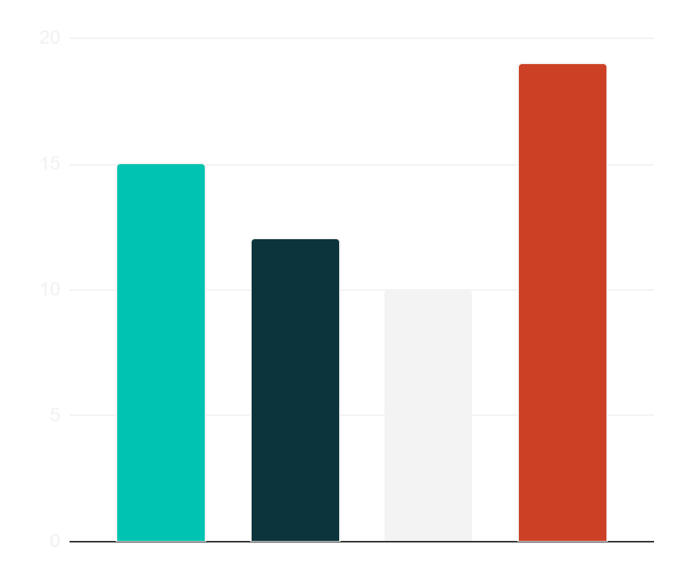
AI TECH AGENCY INFOGRAPHICS
OUR SCHEDULE
12h
JUPITER
Jupiter is a very big planet
19h
VENUS
Venus has a toxic atmosphere
15h
MARS
Mars was named after a god
Jupiter
Venus
Mars
Mercury
10h
MERCURY
Follow the link in the graph to modify its data and then paste the new one here. For more info, click here
Mercury is a small planet

Slide 24
AI TECH AGENCY INFOGRAPHICS
HOW WE PROCERE
CHANNELS
BUDGET
25,000,000
Multimedia
DESCRIPTION
GOALS
Saturn is a gas giant and has several rings. It's composed mostly of hydrogen and helium. It was named after the Roman god of wealth and agriculture
You can list your goals here
You can list your goals here
You can list your goals here
You can list your goals here

Slide 25
AI TECH AGENCY INFOGRAPHICS
STRATEGY
01
02
03
VENUS
SATURN
EARTH
Venus is the second planet from the Sun
Saturn is a gas giant with rings
Earth is the third planet from the Sun

Slide 26
AI TECH AGENCY INFOGRAPHICS
OUR VALUES
40% | 60%
MISSION | VISION
Mercury is the closest planet to the Sun and the smallest one in the Solar System | Venus has a beautiful name and is the second planet from the Sun

Slide 27
AI TECH AGENCY INFOGRAPHICS
SOLUTIONS
Mercury is the closest planet to the Sun and the smallest of them all
MERCURY
MARS
Despite being red, Mars is actually a cold place
Venus has a beautiful name and is the second planet from the Sun
VENUS

Slide 28
AI TECH AGENCY INFOGRAPHICS
PLANNING
 | MON | TUE | WED | THU | FRI
08:00 | Insert your own text | Insert your own text | Insert your own text | Insert your own text | Insert your own text
10:00 | Insert your own text | Insert your own text | Insert your own text | Insert your own text | Insert your own text
12:00 | Insert your own text | Insert your own text | Insert your own text | Insert your own text | Insert your own text
2:00 | Insert your own text | Insert your own text | Insert your own text | Insert your own text | Insert your own text

Slide 29
AI TECH AGENCY INFOGRAPHICS
NEXT EVENTS
1
Venus is the second planet from the Sun
Earth is the third planet from the Sun
1ST EVENT
4
2
2ND EVENT
4TH EVENT
3RD EVENT
Saturn is a gas giant with rings
3
Jupiter doesn’t have a solid surface

Slide 30
AI TECH AGENCY INFOGRAPHICS
SOME PORCENTAGES
30%
MARS
Despite being red, Mars is actually a cold place
50%
JUPITER
Jupiter is the biggest planet in the Solar System
25%
SATURN
Saturn is the second-largest planet in the Solar System
75%
NEPTUNE
Neptune is the fourth-largest planet in the Solar System

Slide 31
AI TECH AGENCY INFOGRAPHICS
STAGES
VENUS
EARTH
Venus is the second planet from the Sun
Earth is the third planet from the Sun
MERCURY
MARS
Mercury is the closest planet to the Sun
Despite being red, Mars is very cold
40%
10%
20%
30%

Slide 32
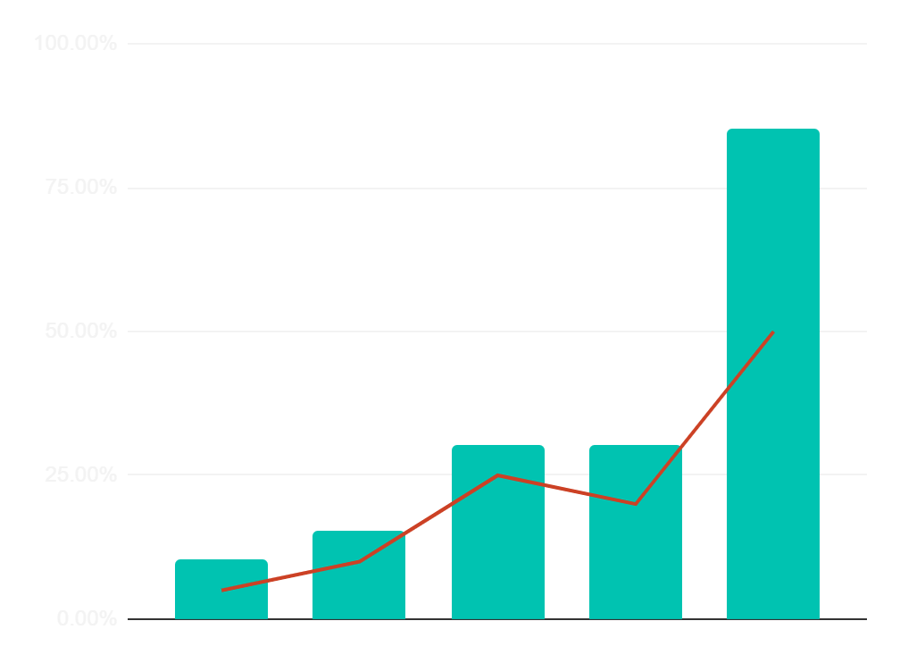
AI TECH AGENCY INFOGRAPHICS
PREDICTED RESULTS
$30,000
Expected income for 20XX
300
New employees next year
Jan
Feb
Mar
Apr
Jun
Follow the link in the graph to modify its data and then paste the new one here. For more info, click here

Slide 33
FINAL CNN MODEL ANALYSIS
TASKS PER MONTH
 | 1 | 2 | 3 | 4
TASK 1
TASK 2
TASK 3
Mercury is a very small planet
Venus is very hot
Mars is cold

Slide 34
CONCLUSIONS
NUMBERS
MERCURY
VENUS
MARS
JUPITER
Mercury is the closest planet to the Sun
Venus is the second planet from the Sun
Despite being red, Mars is very cold
Jupiter is the biggest planet of them all
10%
40%
30%
20%

